Slide 1
Poverty
Jas

Slide 2
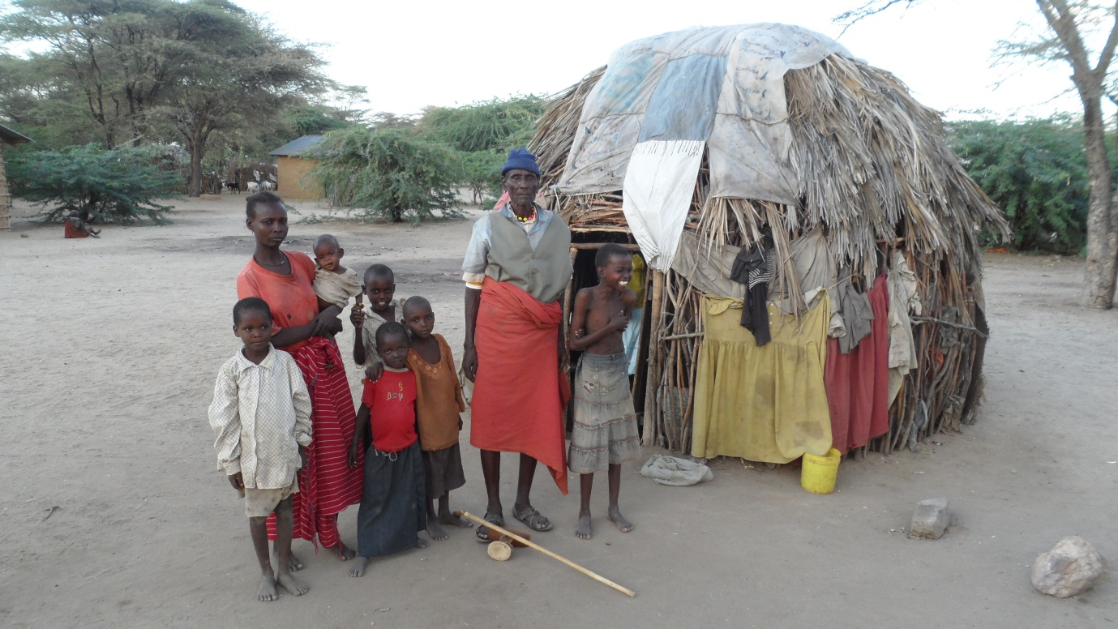
Northern Kenya

Slide 3
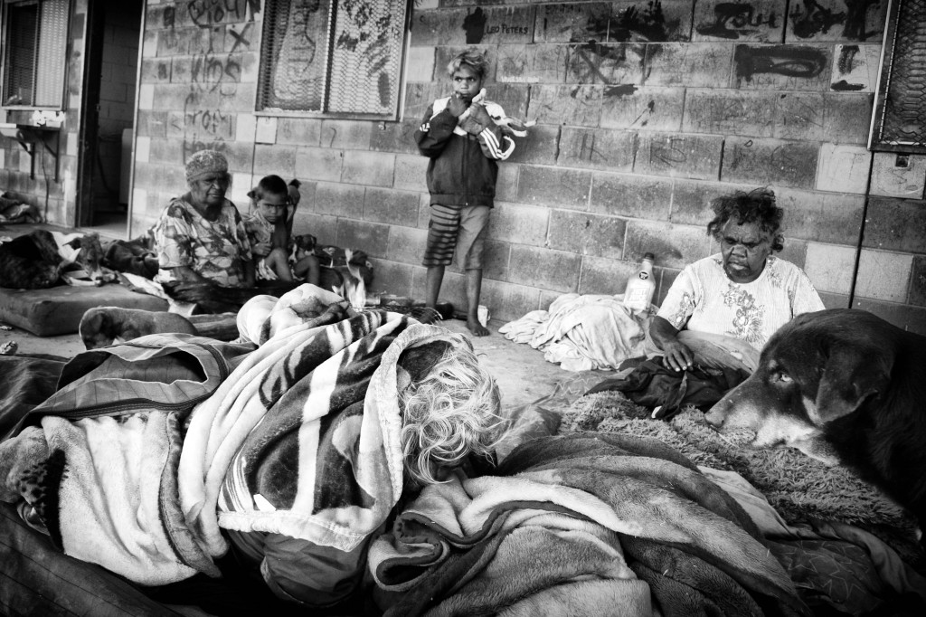
Central Australia

Slide 4
Relativising poverty
Question: can we equate poverty in Australia with poverty in East Africa?
Australia – relative poverty, inadequate access
Turkana – absolute poverty
Kabeer – Widows in India

Slide 5
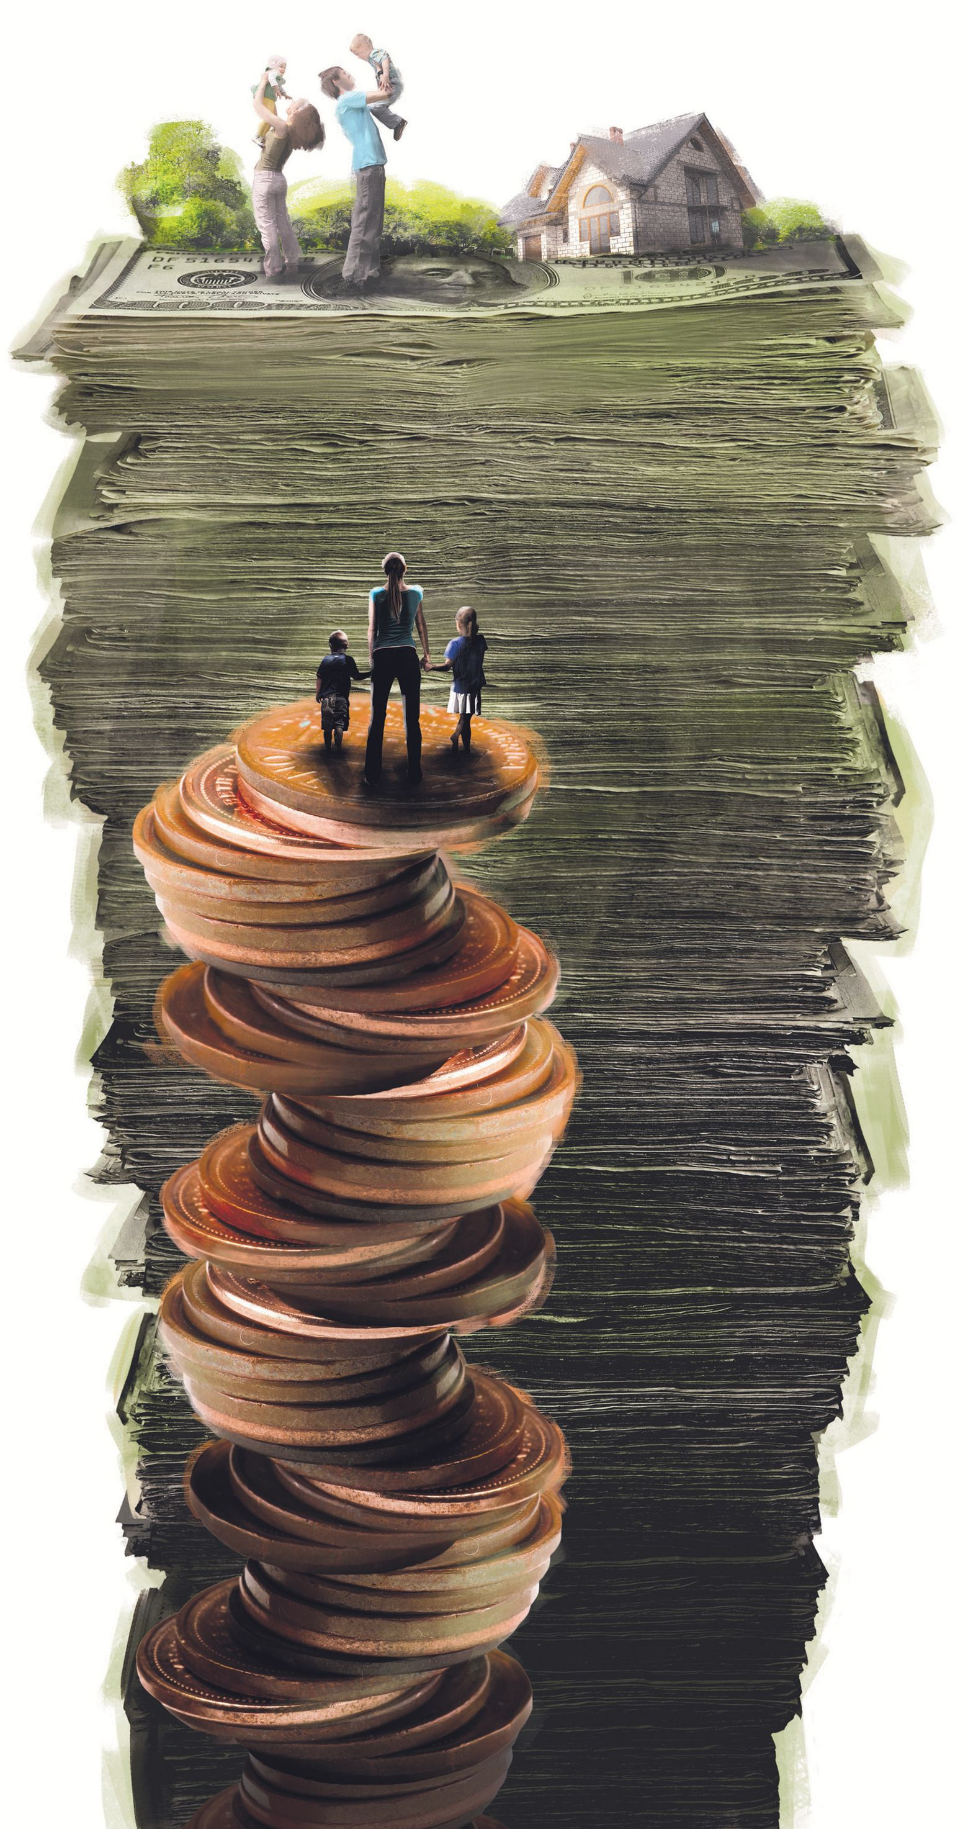
What is poverty?
How to define poverty?

Slide 6
Measuring poverty
Poverty line - $1 - $1.25, $2 a day – an economic state
Basic needs – a biological state
Basic choices –capabilities state –- Amartya Sen – Human Development Index – Human Poverty Index - poverty is ‘unfreedom’ - 1999 Development as Freedom
Social capital – social connectivity state - social safety nets

Slide 7

Who are the poor?
Who plays biggest part in identifying them?
Notes:
Could the discourse be seen as ethnocentric?

Slide 8
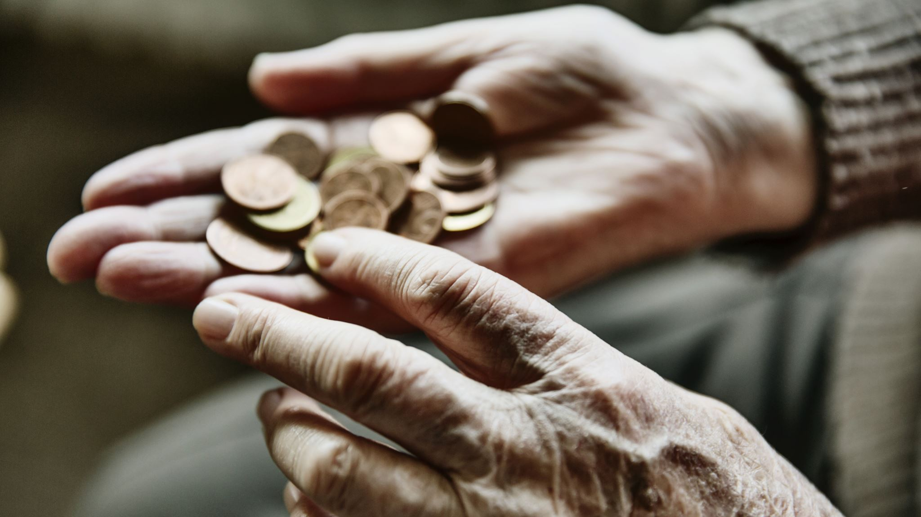
How to relieve poverty ?
Notes:
If you are the government, how to relieve poverty?
Write five things you think that can help relive poverty

Slide 9
Project
You are a leader of a resourceful NGO and you intend to address poverty in a small town in Africa. This town suffer greatly from draught. Villagers need to travel miles away to get water for survival. What would you do to address their poverty issue?

Slide 10
Project
You are a leader of a resourceful NGO and you intend to address poverty in a small village on a Pacific island. Most people living here relying upon fishing to survive. However, due to limited natural resources, villagers are suffering from poverty. What would you do to address their issue?

Slide 11
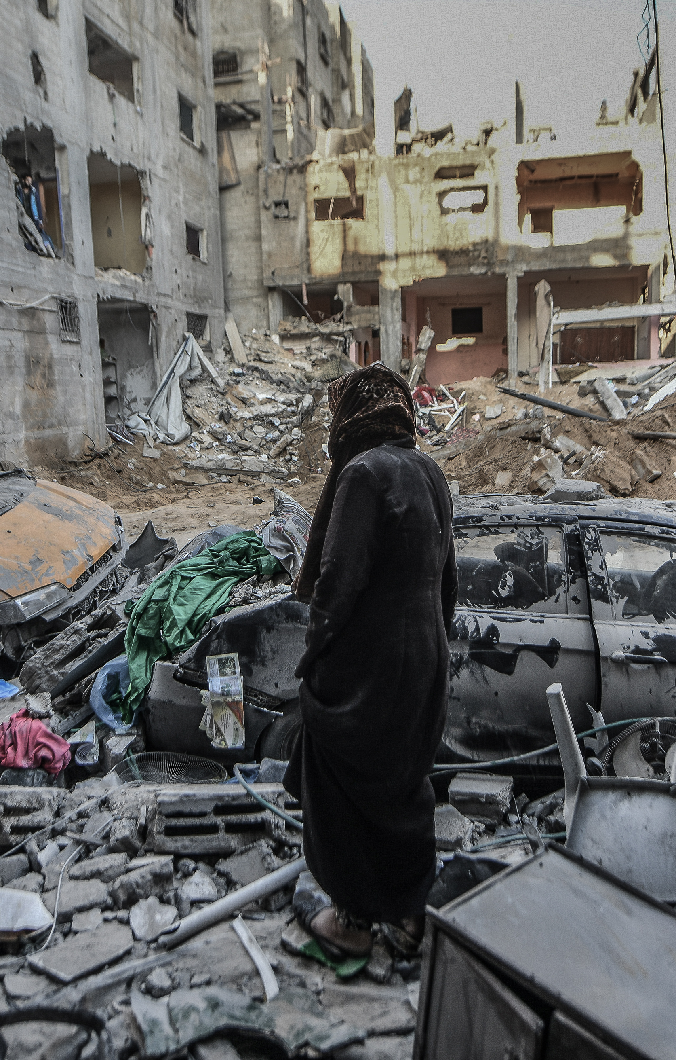
The economics approach (neo-liberal ideology)
Poverty is an economic state into which people fall and can be lifted from
Poverty described in terms of deficits – lack of resources
Solved by economic growth and structural adjustments to economy
Poverty individualised
Poor are a threat to globalisation

Slide 12
Washington consensus
Structural adjustment imposed on debtor countries
Fiscal discipline
Reduce public expenditure
Tas reform to improve incentives
Trade liberalisation
Foreign direct investment
Privatise state enterprises
Deregulation
Well-defined property rights

Slide 13
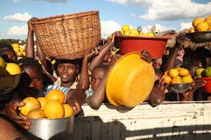
What are some possible downsides of this economics approach?
Notes:
Name three

Slide 14
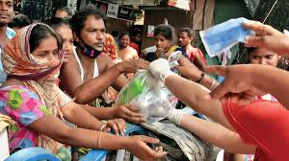
Downsides
selectively integrates into markets,
reduces social protection,
casualises labour,
increases inequality and distributional conflict,
depleting livelihood systems,
precariousness and political subjectivity

Slide 15
Impact of structural adjustment
Susan George 1988 Fate Worse than Debt
NGO Africa Action – argued against impact of structural adjustment – did not build capacity to recover, led to intensified poverty, did not promote long-term development

Slide 16
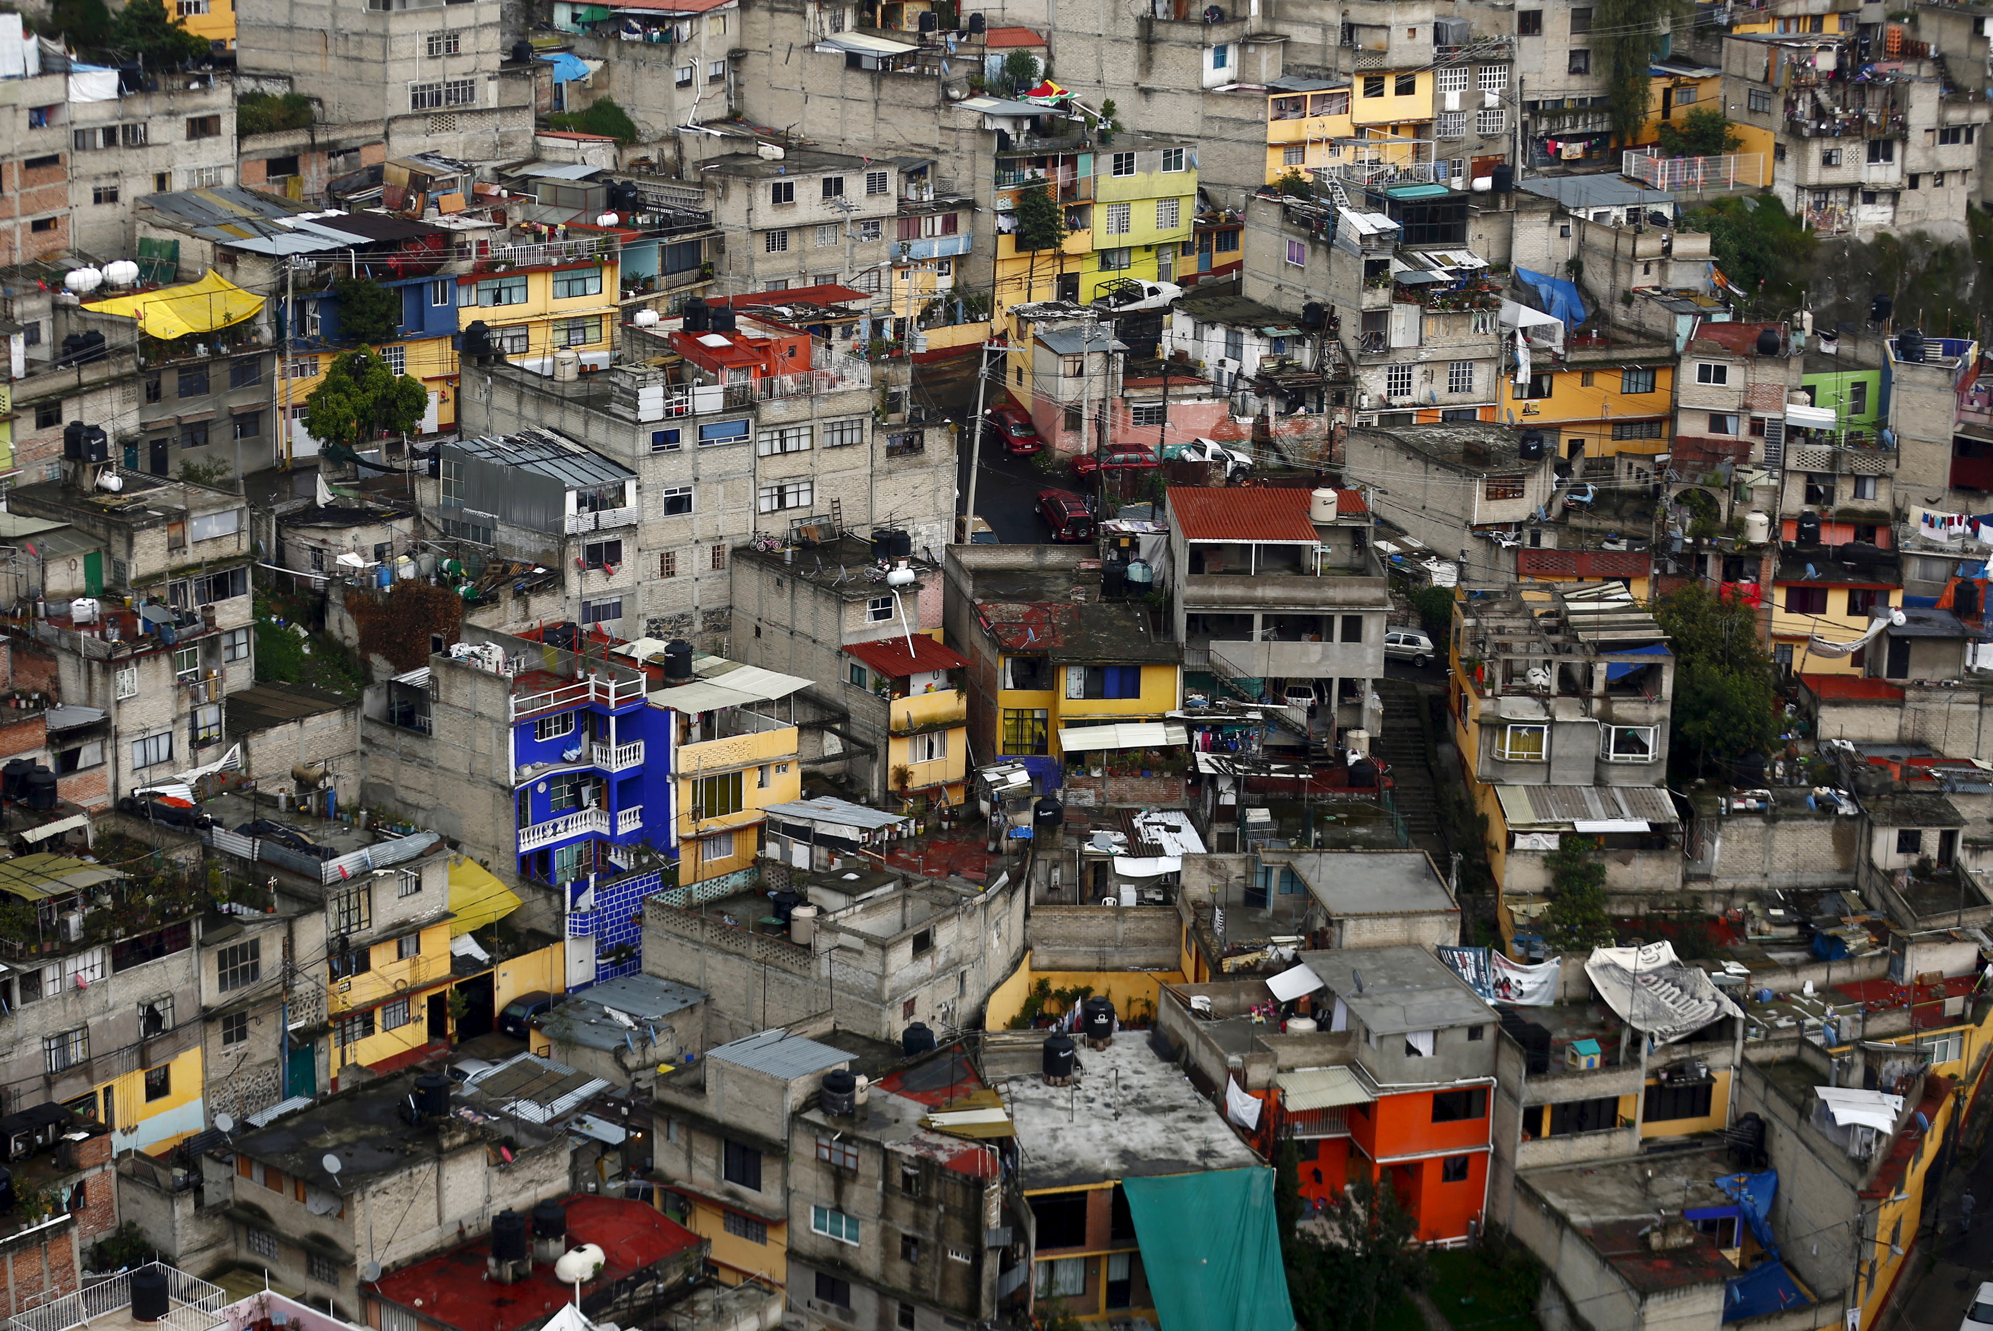
Culture of poverty?
Why poor people are poor?
African people are lazy thus they are poor?
Why Mexico people are poor even when they successfully migrated to America?
Notes:
Blaming the poor and their cultural values – Oscar Lewis 1959 Five Families
Perlman 1976 Rio favelados – not marginal but marginalised
Felipe Bourgois -2009 – Puerto Ricans in New York – ethnic and employment barriers drive to cocaine trade

Slide 17
Poverty in City
Why there is poverty in urban area?

Slide 18
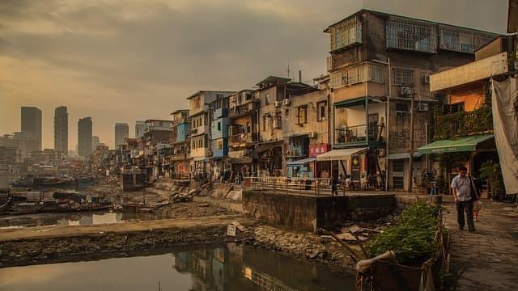
Urban Poverty
Where do poor people live in urban environment?
What do they do?

Slide 19
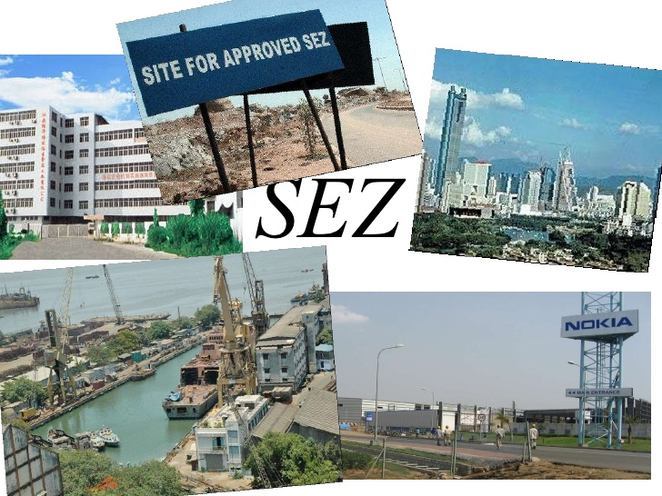
Special Economic Zones
Special Economic Zones
zones of precarity for both wage earners and informal workers

Slide 20
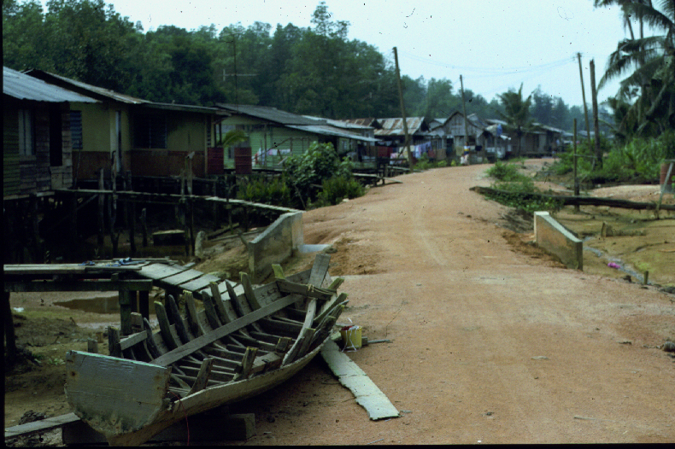
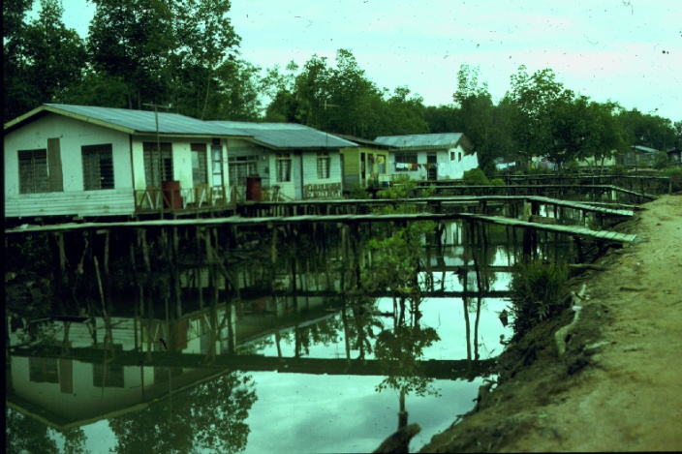
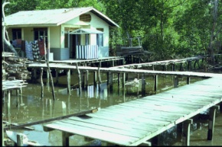
informal
Indonesian illegals
Informal housing, informal employment

Slide 21
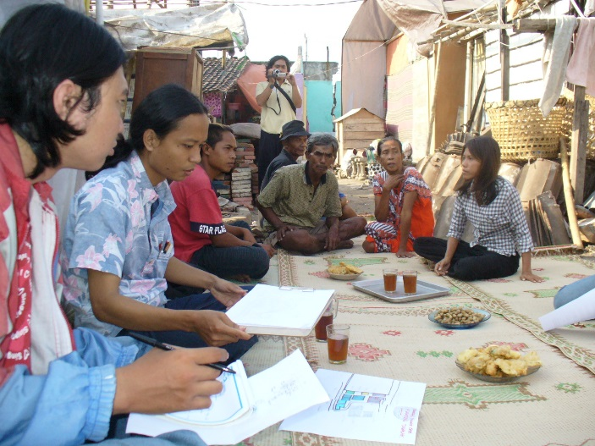
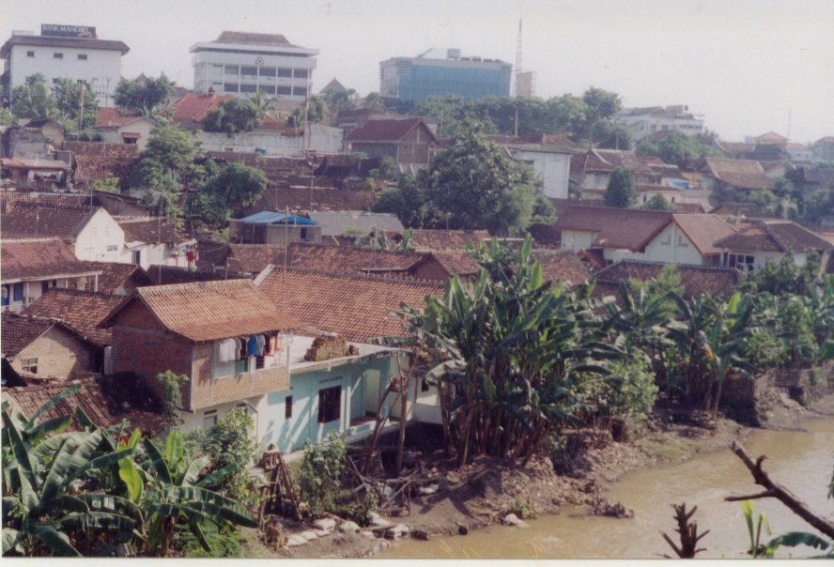
Urban poor in Yogyakarta arisan rotating credit simpan pinjam borrow and loan

Slide 22
Only 40% of the population has wage labour
What does the rest do?

Slide 23
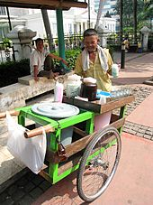
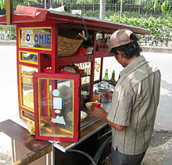
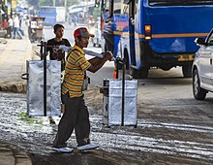
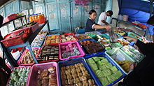
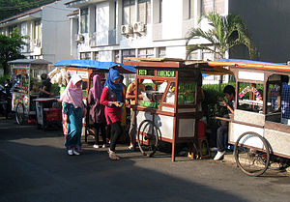
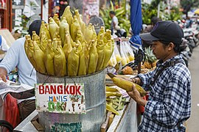
Precarity – survival improvisations

Slide 24
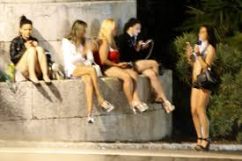
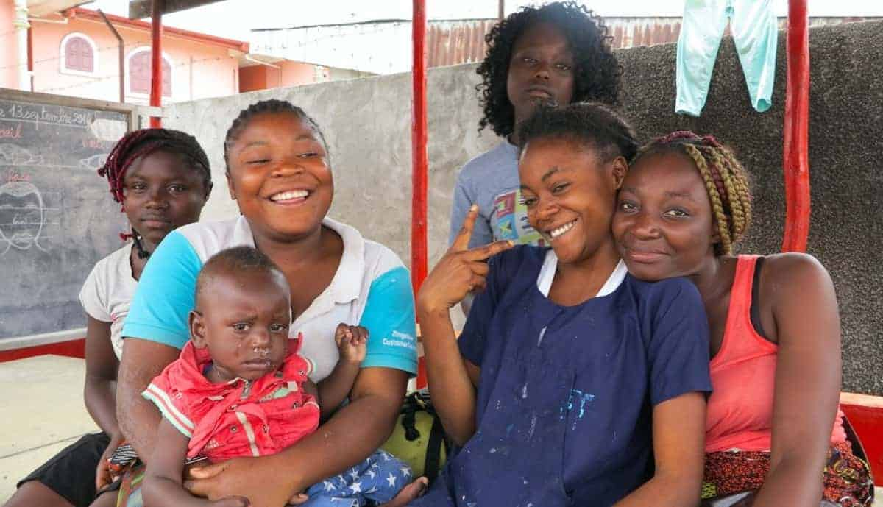
Exchange
Relationship
Prostitution
Begging
….

Slide 25
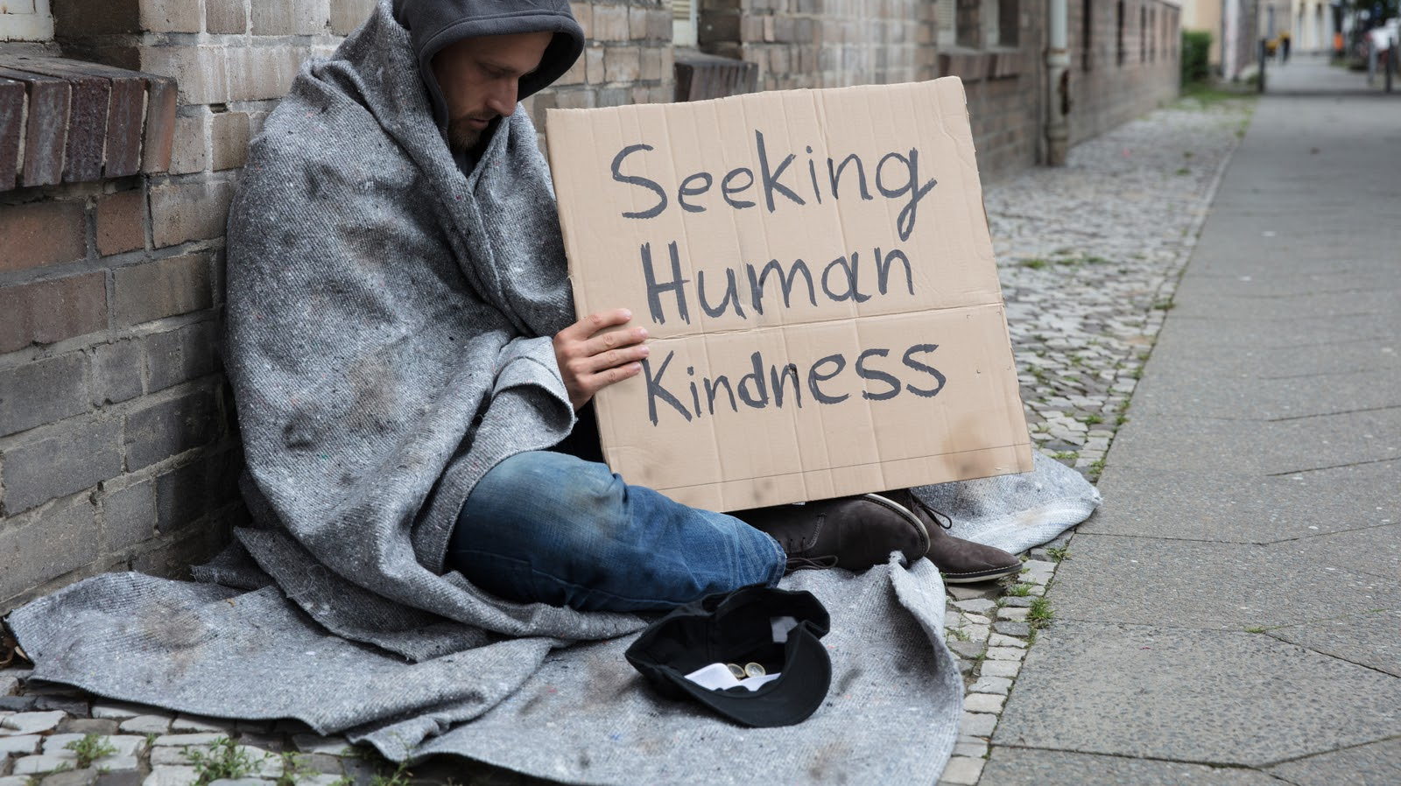
How to address urban poverty?

Slide 26
Urban Poverty Program
Social safety net – poor cards, work programs, credit programs
Power relations remain, agenda set from outside

Slide 27
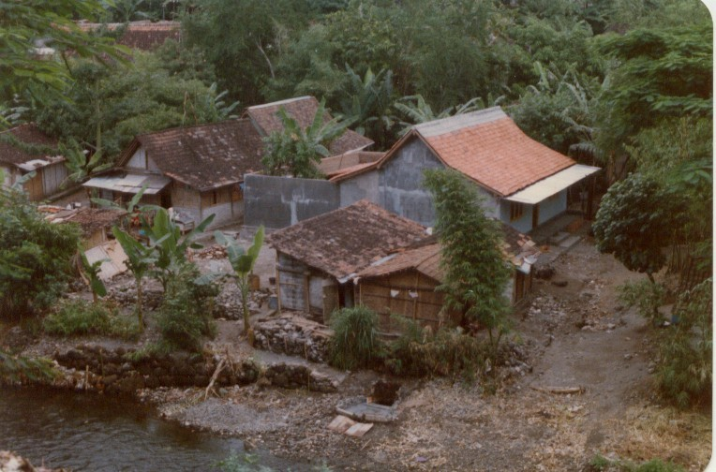
Home improvements

Slide 28

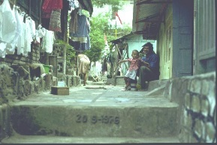
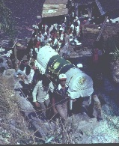
Community events

Slide 29
Basic Income Project
Pilot project in Madya Pradesh 2013 implemented by SEWA
Cash transfer – monthly sum set at about 30% of income of low-income families – unconditional
Empowering – avoiding money lender, investments, savings, food and nutrition, living conditions, schooling, employment, women’s ‘empowerment’

Slide 30

Basic Income

Slide 31
Basic Income
Would you expect this basic income to work well among urban poor in India?
Does the scheme benefit some and marginalise others?

Slide 32
Give a man a fish
Ferguson 2015
Monthly cash payments to 30% of population effective in reducing poverty
Different from Northern welfare models –not the dole

